Slide 1
Village of Wheeler
July 9. 2025 Board Meeting
6:30 Village Hall
105 W Tower Road
Wheeler WI 54772
Agenda
Public Hearing
The Village of Wheeler will hold a Public Hearing at the above location/date/time for the proposed Wastewater Treatment Plant Upgrade facility plan. The purpose of the Public Hearing is to present the Village’s plans for the addition to the plant and gather public comment: A copy of the plan is available online at https://villageof wheelerwi.com/agendas and at the Village Hall during normal hours.
The agenda for the public hearing is:
1. Call to Order
2. Proof of Posting
3. Roll call & Audience in attendance
4. The Village of Wheeler WWTP Facility Plan and alternatives considered.
5. Cost estimate, funding mechanism, and rate impacts
6. Public input on the proposed WWTP upgrade project
7. Answer public questions.
8. Adjourn Public hearing
Residents of the Village of Wheeler are encouraged to attend and present comments. Can be dropped off at the Village Hall before the meeting. The meeting room is handicapped accessible.
Persons needing additional accommodations should contact Don Knutson, Village Clerk, via telephone at 715.632.2449, or via email at: office@vi.wheeler.wi.gov

Slide 2
Wheeler Sanitary District Village of Wheeler, WI July 9th, 2025 Facility Planning Public Hearing
CBS Squared Engineers
Tyler Hastings
Haden Hau

Slide 3
Agenda
Background
What’s the Problem?
Facility Planning Options
Alternatives Investigated
Cost Estimation
Recommended Alternative
Funding
Income Survey
Schedule
Next Steps

Slide 4
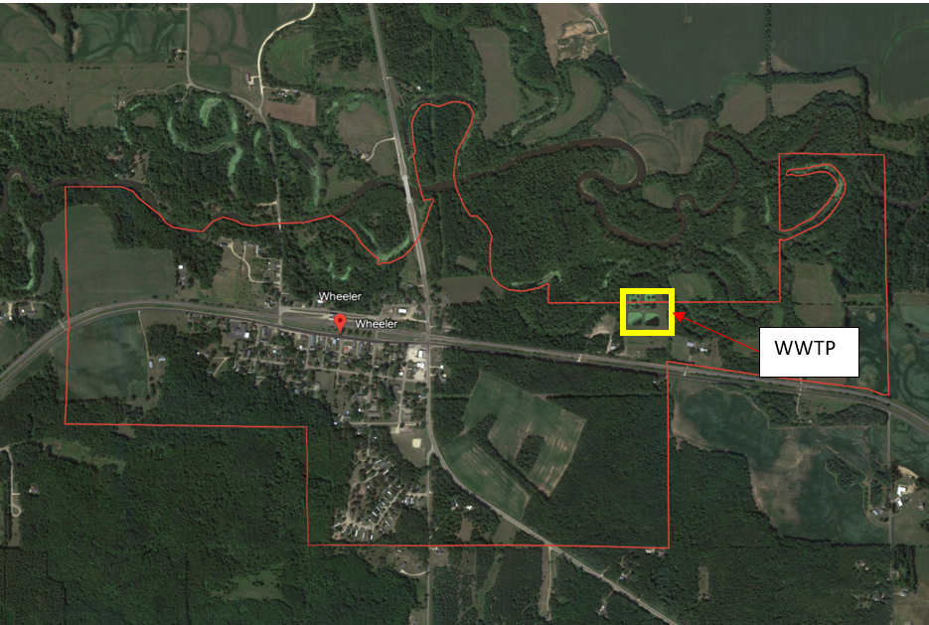
Background
Existing Facilities:
Gravity sewer converges at a single lift station before entering force main to WWTP
2 operating aerated ponds and settling ponds
Chemical dosing
UV disinfection
Optional absorption pond
Discharge to Hay River

Slide 5
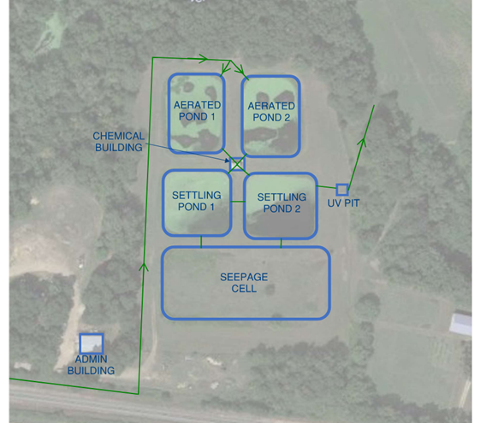
What’s the Problem?
Aging Equipment
Aeration Pond 2 is malfunctioning
Wier system is prone to clogging
UV pit blower and heater are broken
Non-automated alum addition system
Wastewater lagoons struggling to meet current phosphorus limit of 152 lbs/year, but have done so with difficulty, future limits are expected to decrease.
Upgrades to WWTP or changes to management of wastewater needed to meet decreasing phosphorus limit and improve operation safety.

Slide 6
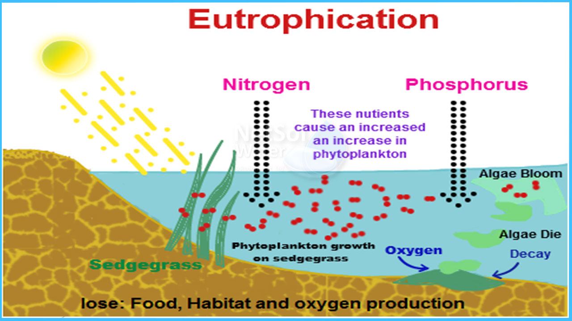
What’s the Problem? - Eutrophication
Wisconsin DNR regulates surface water phosphorus discharges to prevent eutrophication
Too much phosphorus and algae growth can cause fish die-offs and excess bacteria in the water
Maintaining healthy nutrient balances keeps water bodies fishable and swimmable

Slide 7
Facility Planning Alternatives
Alternative 1: Do Nothing – Not Pursued
Keep operating the WWTP as is, resulting in violations and fines in the future
Not pursued
Alternative 2 : Lagoon Upgrade with Continuously Backwashing Filters
Upgrade the WWTF equipment, add tertiary treatment
Repairs to Aging Infrastructure · Sludge Removal · Supervisory Control Data Acquisition (SCADA) · Sand Filter Backwashing

Slide 8
Facility Planning Alternatives
Alternative 3: Lagoon Upgrade with Cloth Disk Filtration
Install new phosphorus treatment equipment following the lower lagoon to meet effluent limits
Repairs to Aging Infrastructure · Sludge Removal · SCADA · Cloth Disk Filtration
Alternative 4: Lagoon Upgrade with Conversion to Absorption Pond Discharge
Install new phosphorus treatment equipment following the lower lagoon to meet effluent limits
Repairs to Aging Infrastructure · Sludge Removal · SCADA · Connection to Existing Absorption Ponds · Monitoring Wells

Slide 9
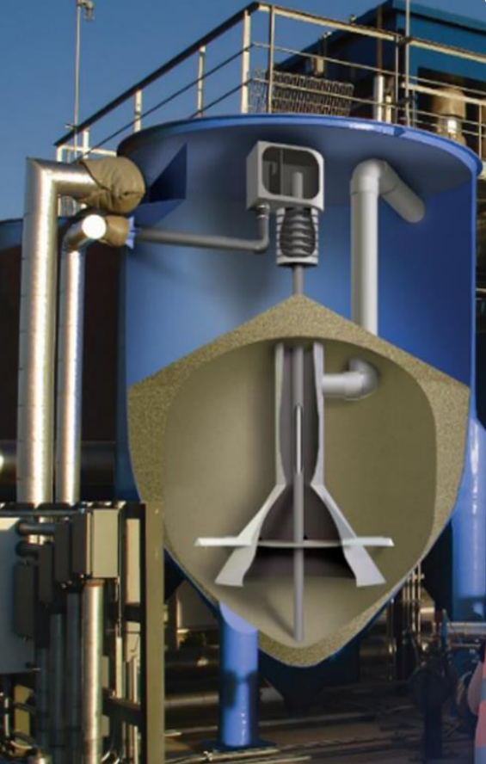
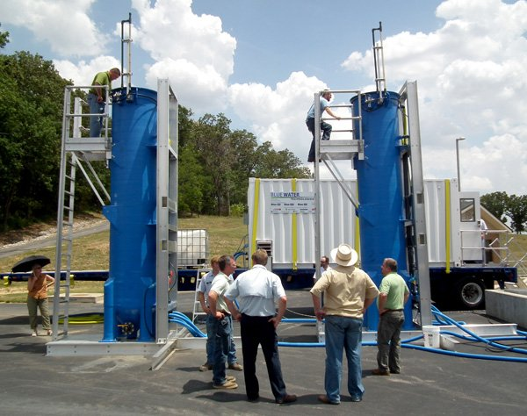
Lagoon Upgrade with Continuously Backwashing Filters
Installation of recirculating sand filter units, which bind and remove phosphorus from the wastewater
Must reduce solids concentration prior to filter units to prevent clogging
SCADA remote monitoring
Significant upgrades to the WWTP needed to meet phosphorus limits:
New electrical and water service on-site
Lift station to feed filter units
Recycle lift station

Slide 10
Lagoon Upgrade with Continuously Backwashing Filters
PROS
CONS
Proven method for phosphorus removal with several installations within the state
Increased BOD and TSS removal efficiency
Automated systems provide operations with limited operator intervention
Maximizes WWTF’s current resources while achieving effective treatment
Increased mechanical and operational complexity at the WWTP
Increased cost associated with operator time commitment
Additional costs associated with metal salt usage and recycle pumping
New lift stations required to pump water to units and recycle solids to headworks and provide storage volume for filtration

Slide 11
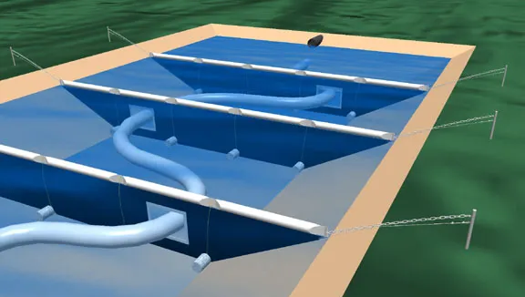
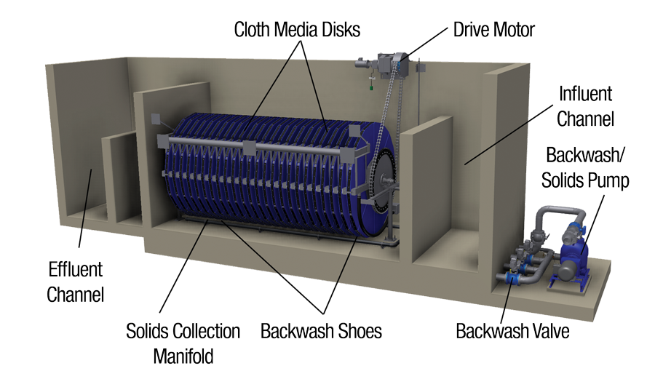
Lagoon Upgrade with Cloth Disk Filtration
Significant upgrades to the WWTP needed to meet phosphorus limits:
New electrical and water service on-site
New baffle in the lower lagoon to reduce solids prior to filtration
Lift station to feed filter units
Chemical feed system
Recycle lift station
SCADA Remote Monitoring
Increased operational and maintenance cost due to complex systems

Slide 12
Lagoon Upgrade with Cloth Disk Filtration
PROS
CONS
Proven method for phosphorus removal with several installations within the state
Automated systems provide operations with limited operator intervention
Increased mechanical and operational complexity at the WWTP
Increased cost associated with operator time commitment
Additional costs associated with metal salt usage and recycle pumping
New lift stations required to pump water to units and recycle solids to headworks and provide storage volume for filtration

Slide 13
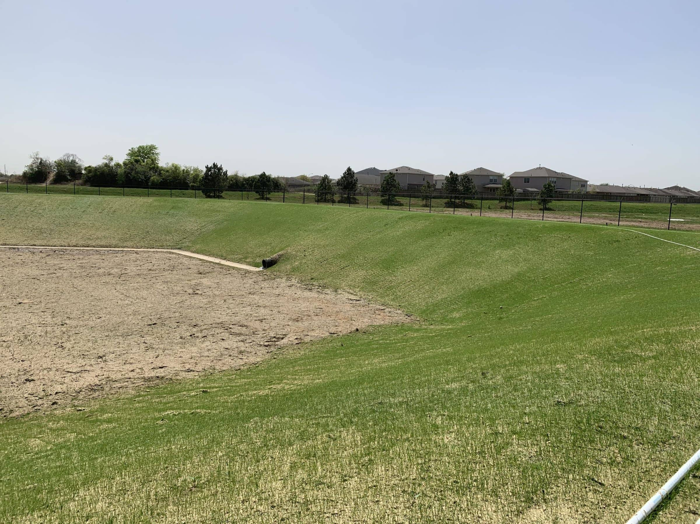
Lagoon Upgrade with Conversion to Absorption Pond Discharge
Treated wastewater allowed to infiltrate into groundwater via several storage cells
Groundwater monitoring wells needed to verify contamination does no leave site
SCADA remote monitoring

Slide 14
Lagoon Upgrade with Conversion to Absorption Pond Discharge
PROS
CONS
Small disturbance
Prevent future WWTP construction/managements costs associated with DNR regulations and upkeep
Preservation of existing resources
Promotion of sustainable management practices
Minimal maintenance and energy consumption for equipment
Recharges groundwater
Would need additional groundwater wells and annual monitoring
Additional treatment for nitrogen may be needed in the future to address groundwater concerns
Additional equipment that will require maintenance and operation

Slide 15
Alternatives Analysis – Costs
Alternatives were evaluated for using the total present worth of the project
Accounts for 20 years of maintenance costs
WDNR current interest rate applied to total present worth
Alternative | Capital Cost | Total Present Worth
#2 – Lagoon Upgrade with Continuously Backwashing | $4,698,000 | $6,911,244
# 3 – Lagoon Upgrade with Cloth Disk Filtration | $4,855,000 | $7,032,671
# 4 – Lagoon Upgrade with Conversion to Absorption Pond Discharge | $2,303,000 | $4,197,748

Slide 16
Environmental, Health, and Safety
Operating the existing lagoons will have a potential public impact due to odors, potential operational difficulties, and staffing concerns
Continued monitoring and future WDNR regulations may require additional modifications to the WWTP remain compliant
Due to the existing infrastructure and trained staff at Wheeler WWTP, absorption pond utilization poses the lowest risk to the public and the environment

Slide 17
Recommended Alternative: Lagoon Upgrade with Conversion to Absorption Pond Discharge (Alt. 4)
Resolve the stuck valve in Aeration Pond 2
Replace the existing aeration system with a fine bubble system
Fix broken blower and heater in UV pit
SCADA incorporation
Construct connection to absorption pond
Installation of groundwater monitoring wells

Slide 18
ESTIMATE OF PROBABLE COSTS- LAGOON UPGRADE WITH CONVERSION TO ABSORPTION POND DISCHARGE
DESCRIPTION | QTY | UNIT | UNIT PRICE | TOTAL PRICE
Wastewater Treatment Plant Improvements
Mobilization | 1 | LS | $ 100,000.00 | $ 100,000.00
Clearing and Grubbing | 0.25 | Acre | $ 10,000.00 | $ 2,500.00
Silt Fence | 800 | LF | $ 2.50 | $ 2,000.00
Sludge Removal | 1 | LS | $ 100,000.00 | $ 100,000.00
Turf Establishment | 2000 | SY | $ 3.00 | $ 6,000.00
Fine Bubble Aeration System (VFD, fittings and piping, diffusers, probes, building) | 1 | LS | $ 157,000.00 | $ 157,000.00
Blower Control Panel | 1 | Each | $ 20,000.00 | $ 20,000.00
Seepage Cell Refurbishing | 1 | LS | $ 75,000.00 | $ 75,000.00
Equipment Building (SCADA panel, Electrical panel) | 1 | LS | $ 300,000.00 | $ 300,000.00
Installation | 1 | LS | $ 159,950.00 | $ 159,950.00
SCADA | 1 | LS | $ 225,000.00 | $ 225,000.00
WWTP Electrical | 1 | LS | $ 75,000.00 | $ 75,000.00
Meter/Weir | 1 | LS | $ 100,000.00 | $ 100,000.00
Remove and Dispose of Settled Sludge | 1 | LS | $ 170,000.00 | $ 170,000.00
Outdated Equipment Abandonment | 1 | Each | $ 100,000.00 | $ 100,000.00
Total WWTP Improvement Cost |  |  |  | $ 1,592,450.00
Seepage Cell Evaluation
Seepage Cell Evaluation | 1 | LS | $ 25,000.00 | $ 25,000.00
Geotechnical Exploration | 1 | LS | $ 20,000.00 | $ 20,000.00
Geohydrologist Evaluation | 1 | LS | $ 25,000.00 | $ 25,000.00
Total Seepage Cell Evaluation Costs |  |  |  | $ 70,000.00
Total Other
Engineering (contract) |  |  |  | $ 390,320.000
Contingency |  |  |  | $ 159,245.000
Funding Administration |  |  |  | $ 5,000.000
Legal |  |  |  | $ 10,000.00
Bonding |  |  |  | $ 20,000.00
Interim Interest |  |  |  | $ 36,000.00
Auditing |  |  |  | $ 15,000.00
Financial Consultant |  |  |  | $ 5,000.00
Total Other Costs |  |  |  | $ 640,565.00
Total Capital Costs |  |  |  | $ 2,303,015.00

Slide 19
Funding
Acquired from United States Department of Agriculture-Rural Development (USDA-RD)

Slide 20
User Rate Impacts
USDA Loan= 4.125% APR
Assuming no grant funding or reduced interest rate
Total Loan Amount | $2,303,015
Loan Interest Rate | 4.125%
Average Monthly User Fixed Rate | $23.81
Average Future Monthly User Rate | $173.24
Percent Increase | 628%

Slide 21
Tentative Project Schedule
2025
Facility Plan to WDNR to describe need for project and alternatives evaluated (May 2025)
Land easement agreements with any land owners
Utility permission from Dunn County
Construction Start (June 2026)
Substantial Completion (November 2026)
Project Final Completion (December 2026)
2026
2027
2028

Slide 22
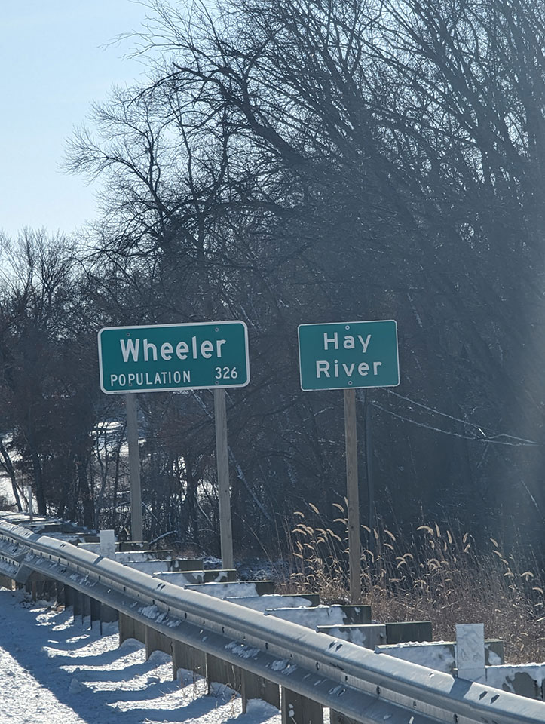
Next Steps - Action Items
Finalize regionalization agreement with Village of Wheeler
Initiate Sanitary District income survey
Obtain land easements and County approvals for force main route
Begin design of list station and force main for regionalization

Slide 23
Questions

Slide 24
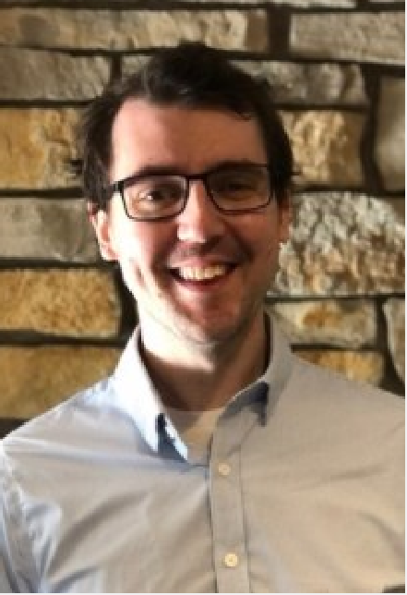
Thank You!
Alex Roll
(248) 884-1685
aroll@cbssquaredinc.com
Alex Roll

Slide 25
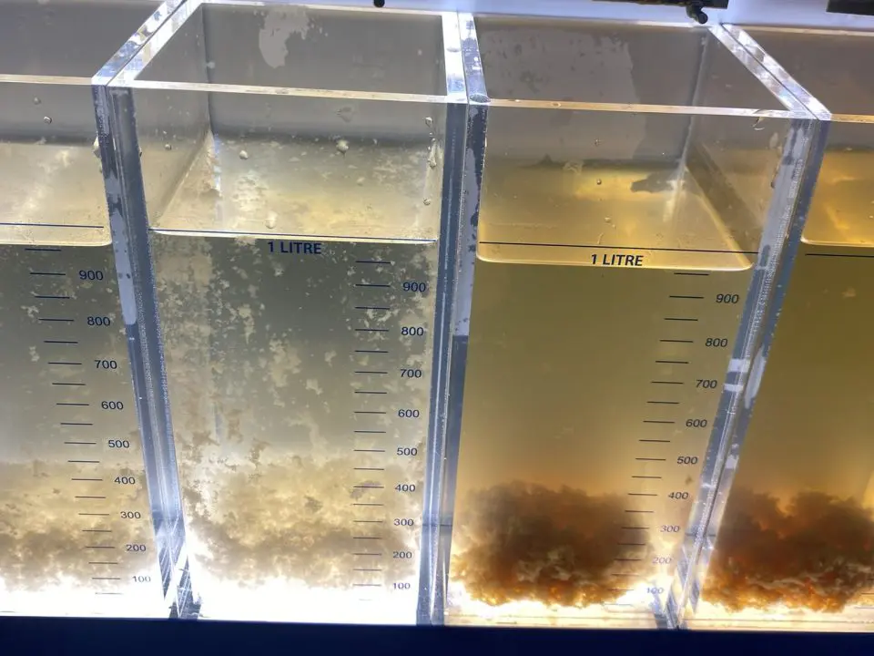
Short-Term Phosphorus Management
Add metal salts to the lagoon to bind and drop-out phosphorus from the wastewater.
Approval from Wisconsin DNR for:
Metal salt boat dosing in the lower lagoon
Metal salt dosing at the manhole between the lagoons
Treatment will be effective for meeting the Interim phosphorus limits.

Slide 26
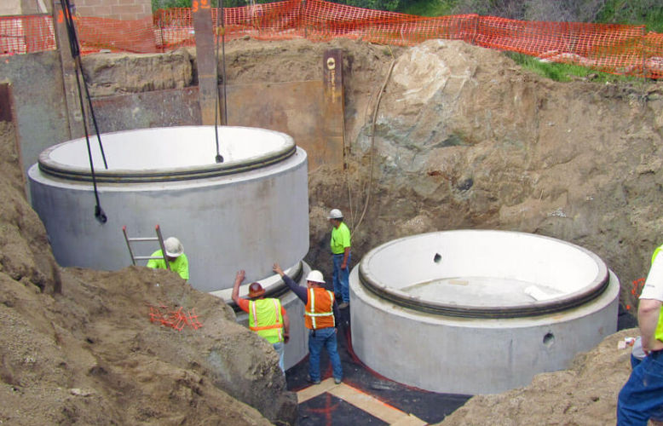
Long-Term Phosphorus Management - Facility Planning
Long-term solutions will require more robust upgrades to the WWTP
Upgrades to existing facilities or major change in wastewater management
Wisconsin DNR requires facility planning when major changes are needed
Facility Planning
Estimate projected flows and loadings for the existing facility
Verify that WDNR regulations are met at the WWTP
Evaluate several alternatives to identify the most feasible and cost-effective option for long-term operation

Slide 27
Tentative Project Schedule
2024
CDBG Funding application with design plans due (May 15th, 2025)
CWF Application with design plans due (Sept 30th, 2025)
Bid force main project for regionalization with City of Durand (Winter 2025-2026)
Begin construction of force main project (March 1st, 2026)
Complete construction and decommissioning of WWTF (November 2026)
2025
2026
2027

Slide 28
WI DNR – Clean Water Fund Loan Program
Revolving fund loan program the provides reduced market rate loans and Principal Forgiveness.
Loan rates range from 0% to 55% of the published market rate.
Principal forgiveness and reduced market rate loans based on:
Community Median Household Income
Population/Population Trends
Unemployment Rate
Other factors
Repayment periods of 20 or 30 years.

Slide 29
Community Development Block Grant (CDBG) Requirements
Up to $1,000,000 provided for community projects.
Environmental must be completed prior to application.
Biddable plans and specifications must be submitted with application package.
Applicant must hold a public hearing on the proposed use of CDBG funds.
Project fund must be used to benefit disadvantaged communities.
Income survey must be completed if the area has not been fully classified by the US Census.
U.S. Department of
Housing and Urban Development
Wisconsin Department of Administration
Wisconsin Communities

Slide 30
CDBG Funding – Survey Requirement for Grant Eligibility
To be eligible to apply for grant funding, a current estimate of incomes will need to be completed for residents that will utilize the WWTP.
A survey will be sent to a random sampling of residents residing in households that utilize WWTP services. Participation is voluntary and very important; however, the Sanitary District is required to get a high percentage of responses for the survey results to be valid and qualify the project for grant eligibility.
The survey will tentatively be sent to randomized recipients via mail on October 1, 2024, and will need to be completed by December 31, 2024. Responses requested within 30 days to assist in the funding process.

Slide 31
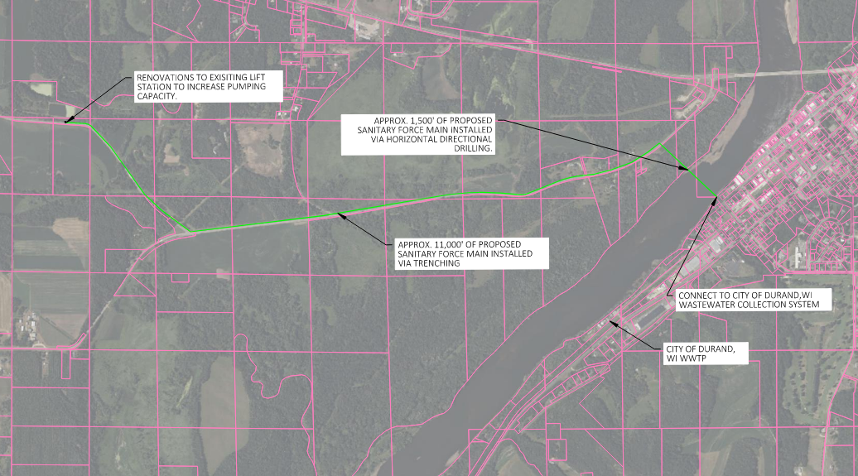

Slide 32
Village Board Meeting Immediately Following Public Hearing
1. Call to order Monthly Village Board Meeting
2. Proof of Posting
3. Roll Call & Audience in Attendance
4. Review and Approval of:
a. June 2025 Minutes
b. Special Board Meeting Minutes
i. Action to Approve Minutes

Slide 33
Village of Wheeler
Minutes
June Board Meeting
May 28, 2025
1. Called to order at 6:30 by President Hakanson
2. Roll Call: Trustee Marten Present, Trustee Milune Present, President Hakanson Present.
3. Attendance: Kevin Kolden, Tyler Hastings, Mercedes Koenig, Leanette Marten
4. Proof of Posting Clerk Knutson stated meeting was posted at the Post Office, Village Hall and the Village website.
5. May Minutes Motion to approve by Trustee Milune second Trustee Marten Ayes 3 opposed 0 motion carried.

Slide 34
6. Reports:
a. Presidents: The Village received permission from the USDA to Proceed on the water projects, bid opening for raze order will be at special meeting June 3, 6:30. Court mistake on address of raze bidding delayed 10 days.
b. Treasurer report see in packet
c. Clerk report see in packet
d. Public works: Reset pumps at well, spray fences perimeter for weeds, Rogers Plumbing working on the concession stand. Mowing grass, flushing hydrants. CCR REPORT OUT PSC REPORT
e. Enforcement: Would also like to see Williams Trail, 223 Evergreen Dog warning notices
f. Building inspector see attached.
Motion to accept reports Trustee Milune, second Trustee Marten Ayes 3 Motion carried

Slide 35
7. Old Business:
a. Siding has been completed
b. Raze order bid opening will by June 3, 2025, at 6:30
c. Approve Pember construction bid on Water works $1,054,000.00 they were the sole bid Pember recommends accepting the sole bid contingent on USDA approval. Motion by President Hakanson to award contingently the water bid to Pember pending USDA approval. Second by Trustee Marten Roll Call Vote. Trustee Milune: Aye, President Hakanson Aye, Trustee Marten Aye, 3 Ayes 0 Nays motion carried.
d. CBS2 also recommends putting the lift station our for bids to expedite the process. President Hakanson motion to bid out the lift station project second by Trustee Milune Roll call vote: Trustee Milune Aye, Trustee Marten Aye, President Hakanson Aye. Ayes 3 Nays 0 motion carried.

Slide 36
8. New business:
a. Motion by Trustee Ryan second by President Hakanson to approve Tobacco and Vaping Licenses to :DG Market, Bridgestop; Issue gaming licenses to : Whistlestop café, 50 Yard Line, Road House 25; Dance License to: Whistlestop Café, 50 Yard Line, Road House 25; Class A liquor/beer license to Bridgestop; Class A Beer license to DG Market; Blass B liquor license to: Whistlestop café, 50 Yard Line Bar, Road House 25 and a temporary alcohol beverage license to the wheeler community Action Club Aug 1-3, 2025 Carried.

Slide 37
b. Motion to issue operator’s licenses pending background checks to by President Hakanson second Trustee Marten: Morgan Main, Nicole sines-Anderson, Emilie Tuschl, Eugene Mewes, Jacqueline Mewes, Alicia Heitkamp, Justina Connell, Kimberly Lorentz, Suzanne Coombs, Kevin Kolden, Audrey Jamieson, Charles Turnblad, Brooke Briese, Amy Hall, Samuel Gamblain. Motion carried.
c. Consideration of heat AC unit for clerks’ office. Motion by Trustee Milune to purchase the PTAC unit from Amazon second Trustee marten motion carried.
d. Consideration of replacing the Village truck Motion by Trustee Milune to accept the quote from Northtown Ford second by Trustee marten carried.
e. No Public comments

Slide 38
9. Motion to adjourn President Hakanson second Trustee Marten Motion carried meeting adjourned at 7:30 pm
Respectfully submitted:
Donald R. Knutson Clerk

Slide 39
Village of Wheeler Special Meeting
June 3, 2025, 6:30
Minutes
Meeting called to order at 6:30
Roll Call President Hakanson Present, Trustee Marten Present, Trustee Milune Present
Proof of Posting: posted at the Village Hall, Post Office and Village website
Opened Bid for razing the former laundromat grocery store:
A&A transport $17,000.00 Rejected wrong building raze bid
Webb Excavating $22,500.00 awarded but bid was removed at request of Webb
Cormican Excavating $29,500.00 Awarded after Webbs request to remove bid.
Motion to accept Webb excavating’s bid by Trustee Milune second Trustee Ryan Motion carried.
Motion to adjourn President Hakanson second Trustee Marten Motion carried
Meeting adjourned at 6:42.
Respectfully submitted Robert Hakanson President.

Slide 40
Special Board Meeting
June 25, 2025
6:30 pm
Minutes
Call to Order 6:30 by President Hakanson
Roll call Trustee Milune Absent, Trustee Marten present, President Hakanson Present
Leanne Ralph Messenger
CMAR resolution 2025062501 Motion to approve Resolution 2025062501 Trustee Marten second President Hakanson Motion Carried.
Dairy State Bank resolution 2025062501 motion to approve resolution 2025062501 by President Hakanson second Trustee Marten motion carried Trustee Marten Aye, President Hakanson Aye Trustee Milune absent
Motion to approve bid from Pember for lift station $1,793,988.00 President Hakanson second Trustee Marten motion carried.

Slide 41
Motion to Adjourn into closed session by President Hakanson at 6:40 second by trustee Marten adjourned
Adjourned into closed session: pursuant to WI Statues 19.85(1 c )) considering employment, promotion, compensation, or performance evaluation data of any public employee over which the governmental body has jurisdiction.
Motion to go into open session by President Hakanson second by Trustee Marten motion carried in open session at 6:46
Motion by President Hakanson to offer $.50 raise to Rand Bates for higher licensing second by Trustee Marten motion carried.
Motion to adjourn by President Hakanson second by Trustee Marten carried
Meeting adjourned at 6:55
Respectfully submitted,
Donald R Knutson Clerk

Slide 42
5. Reports
a. President
b. Treasurer
c. Clerk
d. Public Works
e. Enforcement
f. Building Inspector
g. Fire (if any)
h. EMS (if any)
i. RU (if any)
i. Action to approve Reports

Slide 43
July 9 Treasuers Report 6/29-7/9/2025
Acct Date Tansaction Beg Bal Debit Credit Balance mat date
CD Ind Sand $57,416.60 $57,416.60 10/10/2026
CD Equip Repl Fund $3,263.83 $3,263.83 1/15/2026
CDBG Const Acct $1,000.00 $1,000.00
General Acct 9-Jul 24/7 $24.95 $37,298.93
9-Jul c/n $122.00
9-Jul cintas $71.00
9-Jul cc $89.87
8-Jul dep $2,904.32
8-Jul dep $380.00
7-Jul rob hakanson $1,532.93
7-Jul one source $71.21
7-Jul rand bates $1,750.34
7-Jul donald knutson $1,709.89
7-Jul state of wi transport aid $2,700.61
7-Jul cc $399.43
7-Jul cc $322.17

Slide 44
3-Jul usps- po box rent $100.00
1-Jul trans bond series $3,000.00
1-Jul john deere $437.95
1-Jul bridgestop $123.10
1-Jul craemer consulting $90.00
1-Jul bridgestop $30.45
1-Jul wi dep rev $375.77
1-Jul wi dept of rev $337.36
1-Jul usps stamp $146.00
30-Jun int $61.89
30-Jun cc $200.00
30-Jun cc $170.00
30-Jun dep $1,666.47
27-Jun tribune press $470.49
27-Jun usps $3.91

Slide 45
26-Jun centurylink $14.35
26-Jun usps $3.91
26-Jun cc $102.27
25-Jun can surity direct $510.00
25-Jun menards $362.93
25-Jun dunn cty treas $4.52
25-Jun spypoint $15.00
25-Jun spypoint $15.00
25-Jun spypoint $0.15
25-Jun spypoint $0.15
25-Jun cc 129.21
24-Jun cla $4,200.00
24-Jun xcel $1,818.44
23-Jun bakke norman $2,357.50
23-Jun donald r knutson $1,365.96
23-Jun ctl $523.90
23-Jun psc $355.80
23-Jun spectrum $42.00
23-Jun amazon $108.61
23-Jun village of wheeler $131.25

Slide 46
23-Jun cc $354.65
23-Jun cc $250.00
23-Jun cc $197.65
23-Jun dep $2,272.27
23-Jun dep $982.51
23-Jun dep $811.48
20-Jun northtown ford $9,792.10
20-Jun hawkins $706.09
20-Jun rand bates $1,979.40
20-Jun donald r knutson $1,626.21
20-Jun cc $248.78
20-Jun e check $130.12
12-Nov lindstrom equip $562.00
18-Jun diamond map $14.00
17-Jun tyler olson $50.00

Slide 47
17-Jun spectrum $145.00
17-Jun spectrum $125.76
17-Jun cc $306.21
16-Jun hometown exteriors $4,927.79
17-Jun menards $421.99
16-Jun cc $356.17
16-Jun e check $137.83
16-Jun cc $111.75
16-Jun dep $2,332.97
16-Jun dep $830.86
16-Jun dep $800.00
13-Jun cc $103.02
11-Jun cc $332.29
10-Jun bridgestop $153.95
10-Jun kathi thibado $50.00
10-Jun cc $3.18
9-Jun onesource imaging $97.48
9-Jun cc $299.27
9-Jun cc $100.00
9-Jun cc $80.53

Slide 48
9-Jun e check $66.87
6-Jun dons sweeper service $765.00
6-Jun we energy $31.54
6-Jun cc $75.87
5-Jun bakke norman $1,310.00
5-Jun rand bates $1,719.59
5-Jun cc $230.00
4-Jun amazon $1,161.56
3-Jun lindstrom equip $4,554.00
3-Jun e check $112.00
2-Jun usps stamps $146.00
2-Jun cc $243.67
2-Jun echeck $151.19
30-May amazon $31.22
30-May dep $1,770.62
30-May dep $315.00
30-May etf $1,257.26
30-May dunn cty treas $275.25
30-May cc $186.87
30-May int $94.04
29-May cc $107.69

Slide 49
new const sewer $11,421.11 11421.11
new const water $4,588.32 4588.23
sav bond $5,030.81 $1.18 5031.99
water reserve $58.40 $0.04 58.44
Equip Repl $1,941.15 $1.14 1942.29
machinery equip outlay $102.52 $0.03 102.55
industrial sand donation $62,763.43 $36.72 62800.15
water reserve acct $3,793.41 $2.22 3795.63
loan principal available credit
$85,541.05 $562,458.95
$64,856.48 $676,143.52

Slide 50
Clerks report
New way of trying to save paper at meetings
USDA draw paperwork should e in the end of the week
Prices for Rands Truck (tool box ,ladder rack, back rack) Indianhead $3,870.00 – installed. Amazon 736.78 similar items not installed
Don Family emergency left 2 hours early last Monday unknown if I will have to leave on short notice for my mother in law
Complaint about a tree limb forwarded to John
Florida was 99 degree and 90 percent humidity and only had 2 calls for work.

Slide 51
Old Business:
a. Progress of Raze Order
b. Progress of Water Project (Well/Water Tower)
c. Progress of Lift Station Project
d. Purchased pickup with delivery
e. Donation of chairs for the storm shelter from Dunn County $0.00
f. Progress of Bathroom concession stand repairs

Slide 52
New Business:
a. Report from WCAC on Wheeler Days.
b. Tower Road, road closure July 31, 2025-August 4, 2025
a. Action To Approve Road Closure
c. Hwy 170 closure request with detour and signage.
a. Action to Approve closure/detour for state recommendation.
d. Request comments from Village Board to/for WCAC
e. Resolution for People State Bank to include Donald R. Knutson a signer on accounts
f. Photos for Board Member/Employee ID from Dunn County
g. Initial discussion/planning Hwy 25 project meeting on Wed July 16 (TEAM Meeting-Virtual) with project engineer and State of Wisconsin. 1 p.m. Hwy 170 to Cty. Hwy D 2029-2032 as funding allows (Grinding, Overlay, widen paved shoulders to 5 ft, add shoulder rumble strips, from Cty. Hwy D to 250ft south of Hill Rd, gravel shouldering, replace beam guards, spot replacement of curb and gutter, adjust utility castings, roadside clearing, culvert work, pavement markings).

Slide 53
Any other business for discussion
Adjourn
Action item

